Slide 1
Clinical epigenetics

Slide 2
Epigenetics: modification to DNA or DNA packaging that are transmissible to daughter cells and that do not involve changes to the DNA sequence
Epigenetic marks:
Post-translational modifications of histones
Modifications to DNA
Noncanonical histone variants
Noncoding RNAs
X chromosome inactivation
Many of these epigenetic marks function in gene regulation by altering the structure of DNA and establishing heterochromatin vs. euchromatin
Alternative forms of histones
Heterochromatin is tightly packed and condensed. Which makes it less accessible to the transcription machinery.
Euchromatin is loosely packed and less condensed. Which allows transcription factors and RNA polymerase to access the DNA

Slide 3
Epigenetic regulators: A set of enzymes with specific functions that maintain transcription programs and 3D DNA structure, including histone post-translational modifications and DNA methylation
Histone epigenetic mark abbreviation example:
H3K9ac: acetylation of ninth amino acid (lysine) of histone H3
Epigenetic regulators include:
Writers: place chemical marks on DNA or histones, methyltransferase
Erasers: remove chemical marks, demethylase
Readers: nonenzymatic proteins that bind to specific chemical marks
Remodelers: alter chromatin state/3D structure

Slide 4
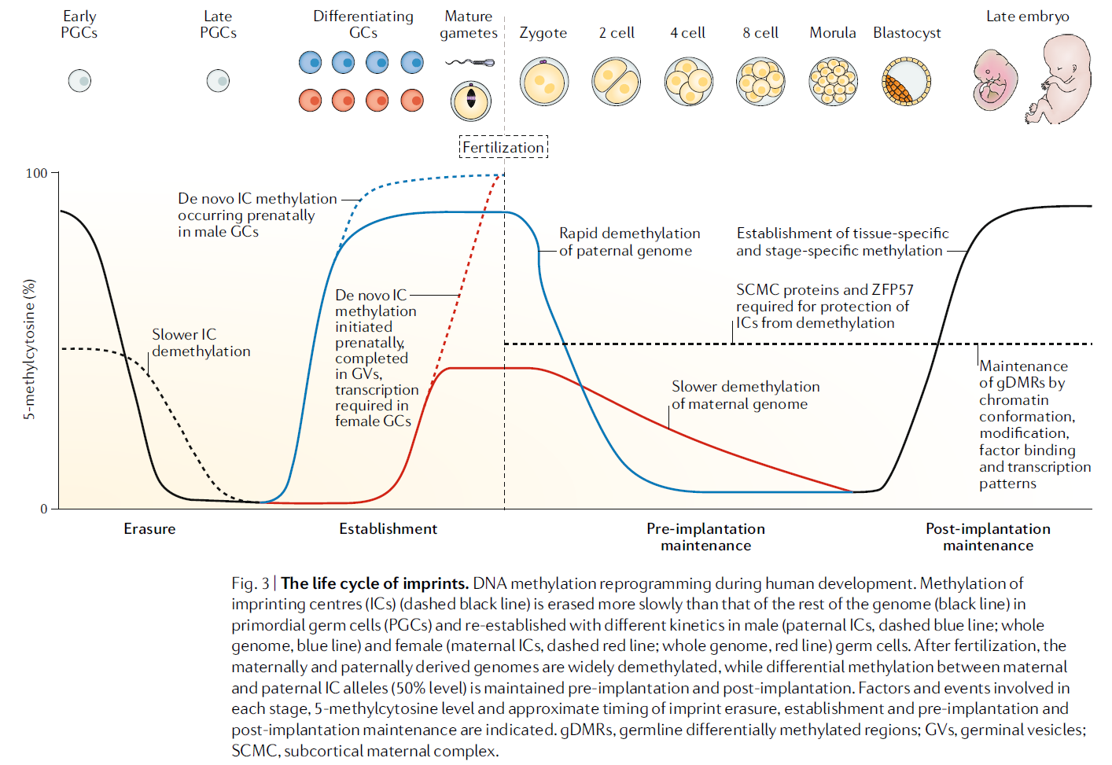
Epigenetics in Development

Slide 5
During primordial germ cell specification in a fetus at ~5 weeks of gestation there is global erasure of DNA methylation followed by remethylation and imprint acquisition in the differentiating germ cells prior to maturing into oocytes or sperm

Slide 7
THE ENVIRONMENT INTERACTS WITH THE EPIGENOME
Environmental factors during fetal development and infancy contribute to chronic disease susceptibility
Geographic links between low birthweight in UK associated with increased fetal mortality, as well as cardiovascular disease
Regions with highest rates of coronary heart disease also had increased infant mortality rates in the decades prior
Poor prenatal nutrition is an environmental risk for both outcomes

Slide 8
Dutch hunger winter established prenatal starvation result in increased risk of obesity, abnormal lipid profiles, cardiovascular disease, and neuropsychiatric disorders
Outcomes differ based on timing of exposure
Exposure during early gestations had normal birthweights (but increased risk of obesity)
Exposure at later gestations had reduced birthweights
Contrasting phenotypes define critical periods during development for a given biologic system where exists a window of sensitivity during which certain environmental exposures can cause lasting changes

Slide 9
Agouti mouse model demonstrates how epigenetic mechanisms act as a temporal bridge between in utero exposures and health outcomes in adulthood
A^{vy} is viable yellow allele, phenotype includes:
yellow fur, obesity, type II diabetes and predisposition to tumors
Associated phenotypes are dependent on levels of DNA methylation at the IAP (intracisternal A-particle retrotransposon)
A diet rich in methyl donors fed to pregnant Agouti mice alters expression of Agouti gene in offspring, which impacts long term health

Slide 10
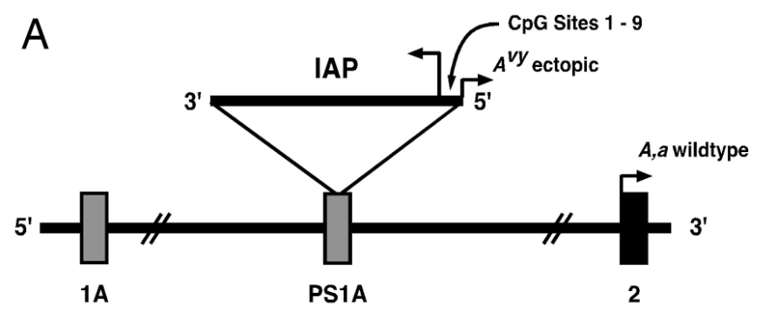
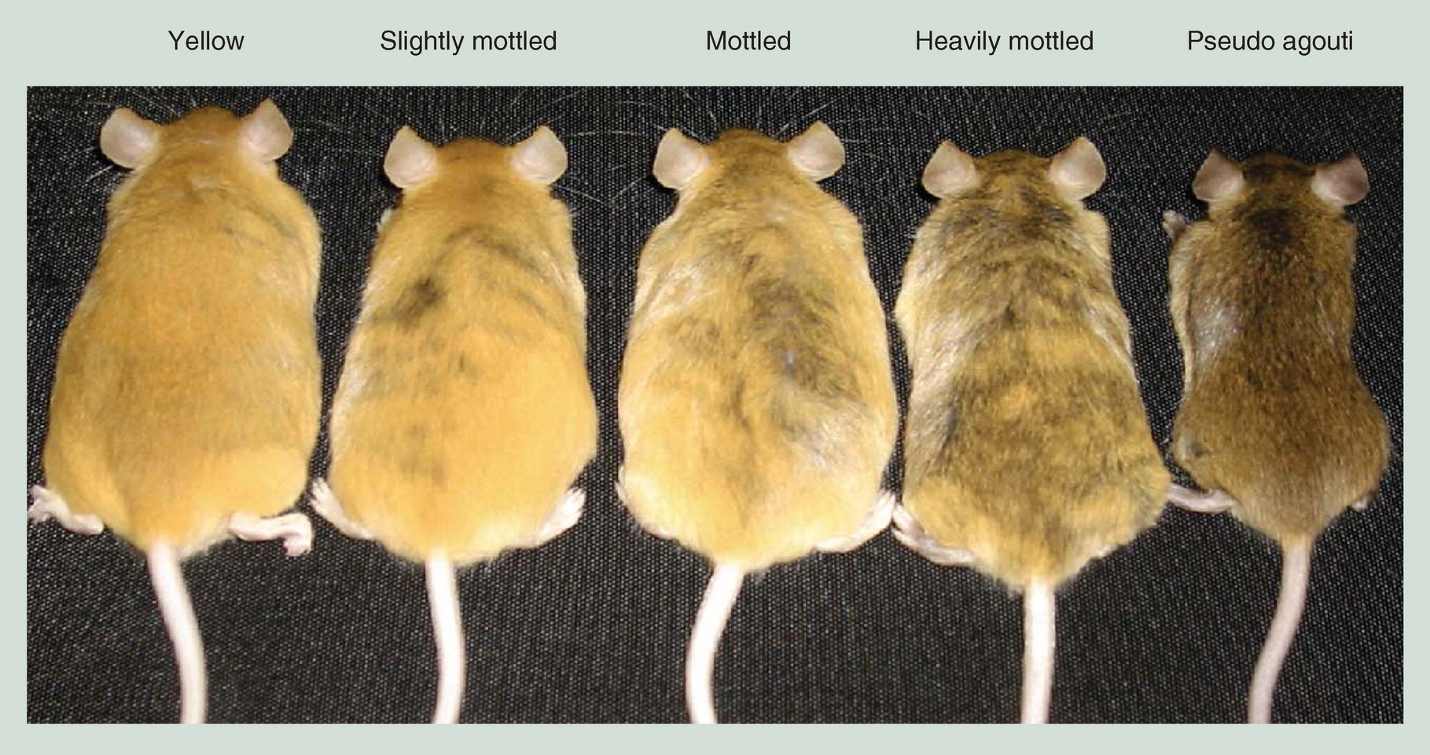
Figure 8.2 Environmentally induced alterations in the epigenome in A^{vy} mouse.
(A) The A^{vy} allele contains a contraoriented intracisternal A-particle insertion within pseudoexon 1A (PS1A) of the Agouti gene. A cryptic promoter (short arrowhead labeled ‘‘A^{vy} ectopic’’) drives constitutive ectopic Agouti expression. Transcription of the Agouti gene normally initiates from a developmentally regulated hair cycle-specific promoter in exon 2 (short arrowhead labeled ‘‘A,a wild type’’).
(B) Genetically identical offspring heterozygous for the viable yellow allele (A^{vy}/a) in the Agouti gene representing the five coat color phenotypes, corresponding to different levels of DNA methylation and associated phenotypes, including obesity. Mice shown are the same sex and age.

Slide 11
Assisted reproductive technologies (ART) is another environmental factor influencing imprinting process
ART can disrupt two critical periods of developmental epigenetic reprogramming:
Oocyte maturation
Retention of gametic imprints following fertilization
Ovarian follicular stimulation may activate oocytes that are not yet fully epigenetically reprogrammed

Slide 12
Aspects of ART:
in vitro fertilization
Intracytoplasmic sperm injection
Freezing of embryos
May dysregulate preimplantation epigenetic reprogramming
Risks of adverse pregnancy outcomes:
Low birthweight for gestation age
Preterm birth
Congenital malformations
Increased rate of imprinting disorders
Beckwith-Wiedmann, Russell-Silver, Angelman, Prader-Willi
morphologic defect

Slide 13
Across the lifespan, DNA methylation patterns continue to change in both predictable and seemingly random ways
Ongoing changes are illustrated by aging and twin studies
DNA methylation differences in monozygotic twins is associated with many discordant phenotypes:
Psychiatric disorders
Schizophrenia
Bipolar disorder
Autoimmune diseases
Lupus erythematosus
Multiple sclerosis

Slide 14
THE ROLE OF EPIGENETICS IN HUMAN DISEASE
Nuclear transfer experiments in mouse embryos showed that mammalian maternal and paternal genomic contributions to the fertilized egg have different effects on the developing embryo
Zygotes created carrying either two nuclei of maternal or paternal origin generating exclusively embryonic or placental tissue, respectively, but no viable embryos
Hydatidiform moles are androgenetic in origin (two paternal genome, no maternal genome)
Ovarian teratomas are gynogenetic (two maternal genomes, no paternal genome)

Slide 15
Ovarian teratoma reveals well-differentiated fetal structures of all three germ layers (ectoderm, mesoderm, endoderm)
Hydatidiform mole contains only extraembryonic trophoblast elements
Maternally and paternally transmitted genomes are not functionally equivalent. Functional differences are attributed to genomic imprinting

Slide 16
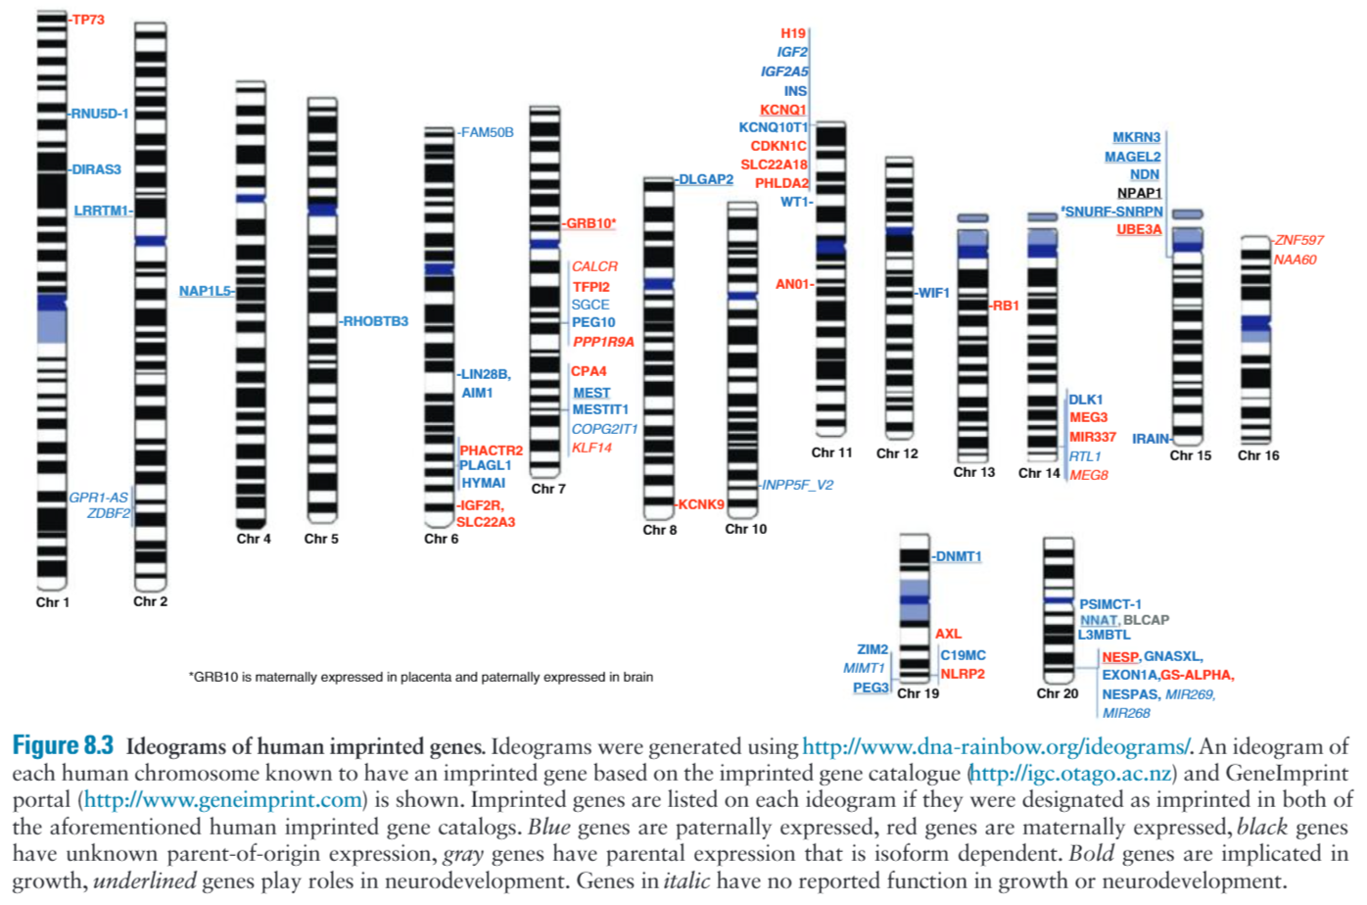
CATEGORIES OF EPIGENETIC DISORDERS
Genomic imprinting
More than 120 imprinted genes

Slide 17
The first human disorders recognized to result from genomic imprinting:
Prader-Willi syndrome: absence of paternally expressed genes
Angelman syndrome: absence of maternally expressed genes
Mechanisms include:
Chromosome deletions
Uniparental disomy
Imprinting defects (epimutation)
Pathogenic sequence variants (UBE3A in Angelman syndrome)

Slide 18
Beckwith-Wiedmann syndrome overgrowth
Russell-Silver syndrome undergrowth
IC1 IGF2 & H19
IC2 CDKN1C, KCNQ1, KCNQ10T1
IC1 is methylated on paternal chromosome: IGF2 expression (promotes cell growth and proliferation), H19 silencing
IC2 is methylated on maternal chromosome: KCNQ1 and CDKN1C expression (negative regulator of cell proliferation), KCNQ10T1 silencing

Slide 19
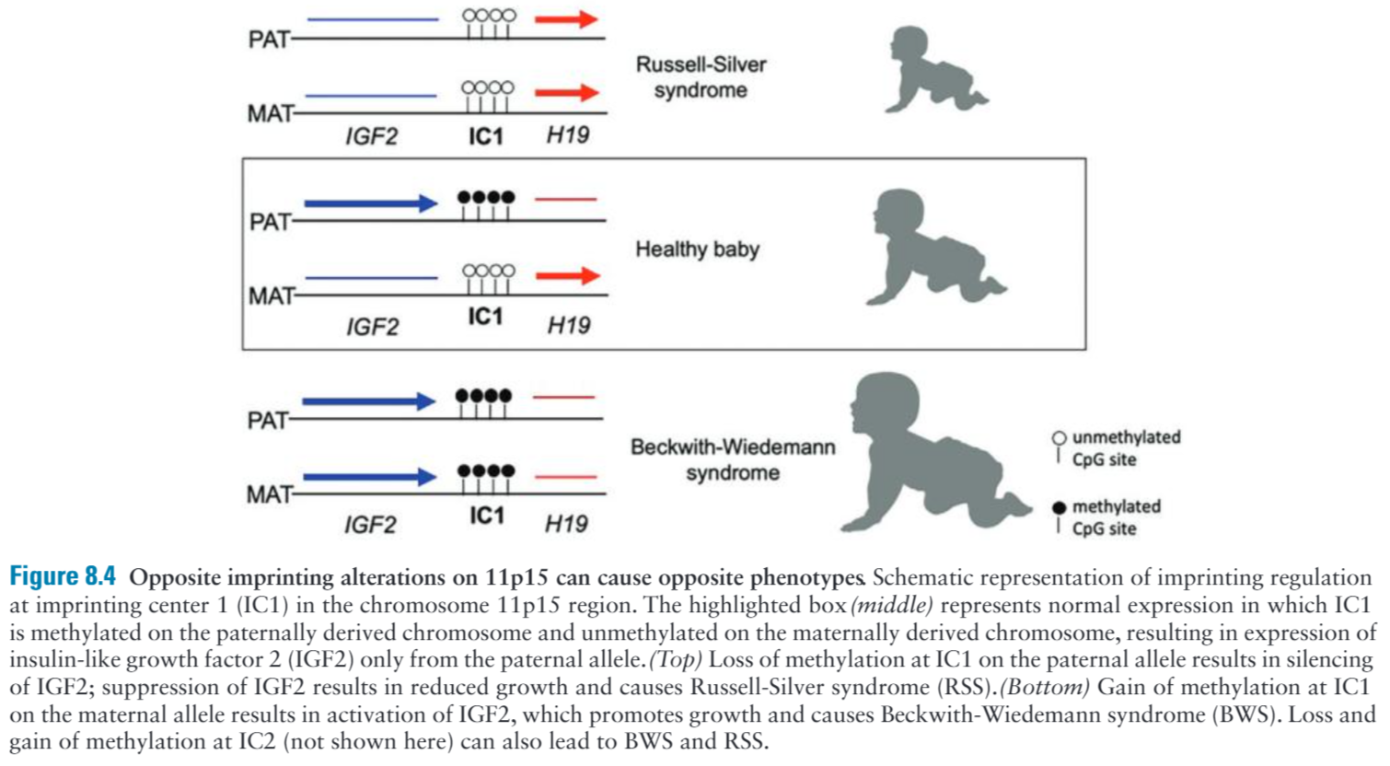
These conditions are mirror images of each other both clinically and molecularly

Slide 20
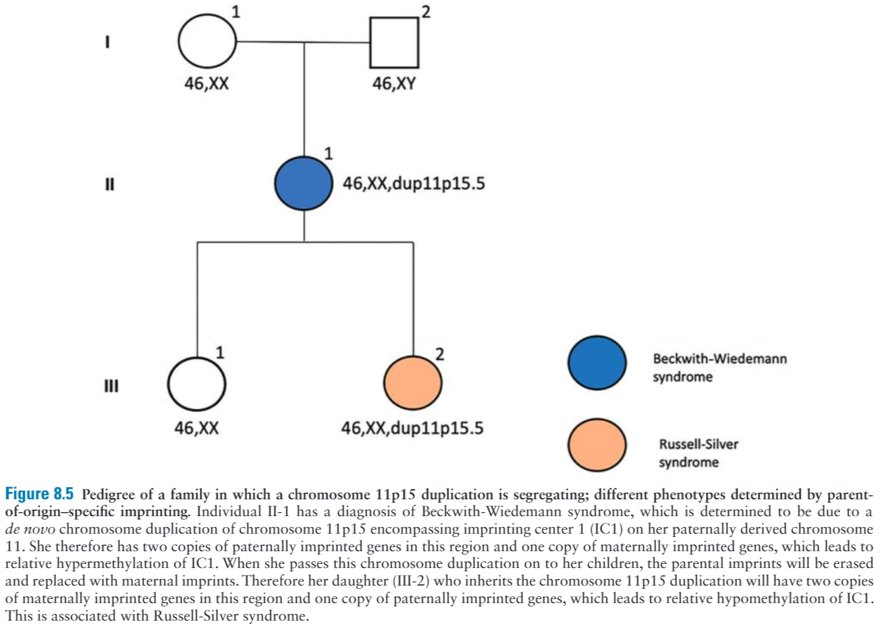
These conditions can be seen in the same family when the underlying etiology is chromosome duplication/deletion that is transmitted through a male versus a female due to parent-of-origin-specific imprinting

Slide 21
Disorders involving unstable repeat expansions
In Fragile X syndrome, expansion of FMR1 CGG repeat to full mutation triggers epigenetic events including methylation of FMR1 promotor leading to reduced or absent production of FMRP protein
Epigenetic factors are involved in anticipation; tendency of unstable repeats to undergo expansion when transmitted from parent to child, thereby increasing disease severity and decreasing age of onset in subsequent generations

Slide 22
Disorders of the epigenetic machinery
Increasing number of mendelian disorders recognized to be caused by sequence variants in genes maintaining normal epigenetic regulation, including writers, erasers, readers and chromatin remodelers
In contrast to classical imprinting disorders that impact imprinted genes in cis, for this group of disorders the epigenetic dysregulation occurs in trans, impacting multiple genomic-wide targets

Slide 23
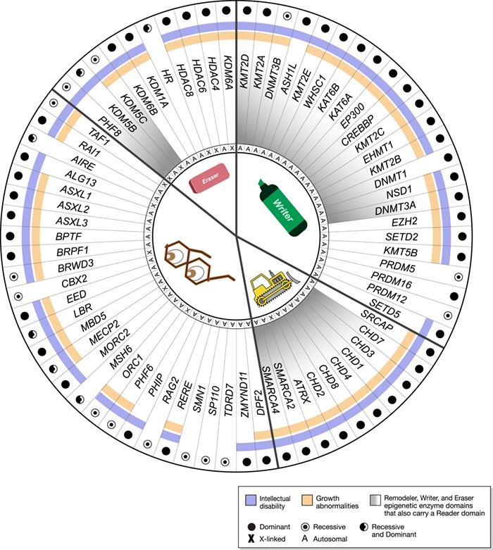
Figure 8.6 Mendelian disorders of the epigenetic machinery. Over 70 genes with defined epigenetic domains (reader, writer, eraser, remodeler, middle icons) have been linked to Mendelian phenotypes. The majority of genes cause disease in the heterozygous state (filled circle). Enzyme domains (writer, eraser, remodeler) are mutually exclusive in any given factor but many coexist with a reader domain (gray shading). ID is seen in the vast majority (blue), as are growth abnormalities (orange). A indicates genes on autosomes; X indicates genes on the X chromosome.

Slide 24
Disorders of the epigenetic machinery: DNA methylation
Methyl-CpG-binding protein 2 (MeCP2) functions as a reader of DNA methylation marks, mutations in which cause Rett syndrome
Classic Rett are generally girls heterozygous for loss-of-function variants
Boys with pathogenic MeCP2 mutation exhibit severe infantile encephalopathy with seizures

Slide 25
Disorders of the epigenetic machinery: Histones
Number of genes involved in regulating histone modifications is much larger than for DNA methylation
Disorders often presents with overlapping phenotypes, difficult to differentiate clinically
Sotos and Weaver syndromes, overgrowth conditions with overlapping features, caused by NSD1 and EZH2 (epigenetic writers)
Sotos: significant intellectual and behavioral problems, Weaver: mild or no intellectual deficits
Recurrence risk
Most cases of Sotos have a de novo etiology
Weaver is often familial, with milder presentation in a parent

Slide 26
Diagnostic testing for epigenetic disorders
Due to heterogeneous molecular mechanisms causing imprinting disorders, one must often utilize more than a single testing methodology to identify the underlying etiology
The most effective first line of investigation is methylation sensitive multiplex ligation-dependent probe amplification (MS-MLPA)
Can assess both methylation levels and copy number variants, distinguish between methylation abnormalities due to deletion, uniparental disomy, or imprinting defect

Slide 27
If a methylation abnormality is detected, additional testing maybe required to determine the specific underlying molecular etiology, microarray or UPD
If MS-MLPA testing is negative, additional testing should be considered: specifically, sequence analysis of relevant imprinting genes (i.e., UBE3A for Angelman syndrome) and cytogenetic analysis

Slide 28
Identification of etiology is critical to determining recurrence risk
A de novo methylation abnormality, without concomitant genetic alteration, would confer a very low recurrence risk
A methylation abnormality due a deletion at imprinting region could confer a 50% risk of recurrence if inherited, depending on parent of origin

Slide 29
Current obstacles to fully understanding the role of epigenetic aberrations in disease pathophysiology:
Sheer complexity of the epigenome, consisting of many interrelated and context-dependent chemical marks
A unique epigenome that exists for each cell type and changes across the life span, especially during development
Baseline levels of stochastic and nonstochastic variation among individuals, similar to that in human genome
ENCODE project (Encyclopedia of DNA Elements): explore epigenetic patterns in chromatin genome-wide in order to better understand control of gene expression in different tissues or disease states

